Slide 1

A web GIS application for integration of socio-economic, biophysical and atmospheric variables: A case study of Punjab province
Presented by: Syed Mustafa Haider and Akram Ali Shah
Department: Space Science
Batch: 5

Slide 2
Content
Introduction to the Project
Literature Review
Study Area
Methodology/ Requirement Analysis
Data Collection/ Acquisition
Data Representation and Visualization
Web Portal Design
Implementation
Results and Conclusion

Slide 3
Introduction to the project
The aim of this project was to develop a web GIS application for the facilitation of data analysis and visualization.
The study area chosen for this project was the province Punjab of Pakistan.
For the visualization following parameters were selected i.e. Land Surface Temperature (LST), Normalized Difference Vegetation Index (NDVI), Population, Precipitation
A responsive and dynamic, webpage designed for the thematic visualization of said Parameters

Slide 4
Literature Review
FEATURES | J. Jumadi and Y. Priyana, “Development and Evaluation of Web GIS Application for Groundwater Management of Karanganyar Regency,” Forum Geogr., vol. 29, no. 2, p. 165, 2016, doi: 10.23917/forgeo.v29i2.1482 | U. K. Gupta, “Forecasting and visualization of NDVI series using statistical methods through Web-GIS Forecasting and visualization of NDVI series using statistical methods through Web-GIS,” no. October 2019, 2020. | L. Liu, D. Li, and Z. Shao, “Design and implementation of a geospatial portal,” Geoinformatics 2008 Jt. Conf. GIS Built Environ. Geo-Simulation Virtual GIS Environ., vol. 7143, no. November, p. 71432E, 2008, doi: 10.1117/12.812616. | E. Gomes, “Creating a Dot Density Map: Resident Population in Mainland Portugal,” Cartogr. J., vol. 54, no. 2, pp. 157–162, 2017, doi: 10.1080/00087041.2016.1148106. | L. Van Trung and D. M. Tam, “Web GIS Solution for Monitoring the Forest-Cover in the Mekong Delta, Vietnam,” J. Geogr. Inf. Syst., vol. 10, no. 05, pp. 491–502, 2018, doi: 10.4236/jgis.2018.105026 | A Web GIS application for integration of socio-economic, biophysical and atmospheric variables: A case study of Punjab province
Data downloading |  |  |  |  |  | 
Dynamic maps and webpage. |  |  |  |  |  | 
Graphical representations of data |  |  |  |  |  | 
Database |  |  |  |  |  | 
User provided data |  |  |  |  |  | 
Real-time Spatial data analysis |  |  |  |  |  | 
Map navigation menu(map tools) |  |  |  |  |  | 
Temporal data analysis |  |  |  |  |  | 
Thematic maps |  |  |  |  |  | 

Slide 5
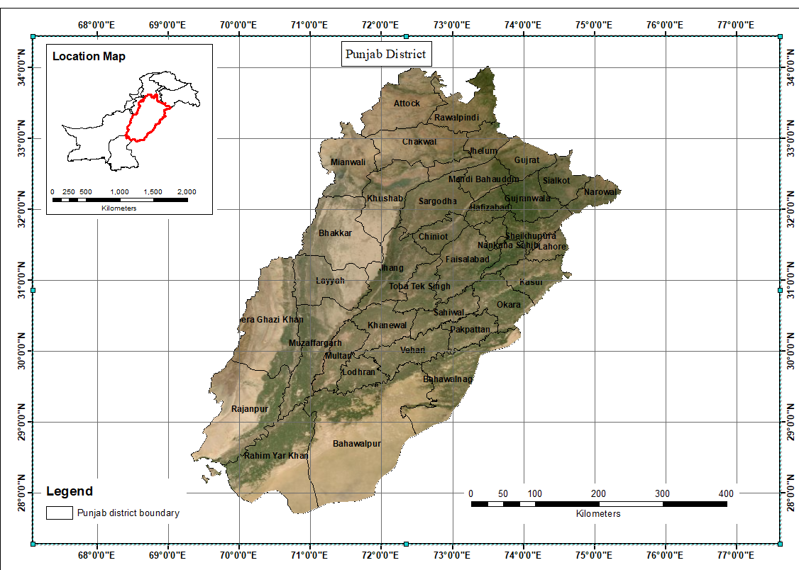
Study Area:
The name Punjab means “five waters,” or “five rivers,” and signifies the land drained by the Jhelum, Chenab, Ravi, Beas, and Sutlej rivers, which are tributaries of the Indus River.
It is situated in the 31°N 72°E (latitude and longitude) coordinates
It is bordered by the Pakistani provinces of Sindh, Baluchistan, and Khyber Pakhtunkhwa, the enclave of Islamabad, and Azad Kashmir
It is Pakistan’s most populous province, with an estimated population of 110,012,442 approximately as of 2017 and the total area it covers is 205,344 km²
It lies on the margin of the monsoon climate. The temperature is generally hot, with marked variations between summer and winter

Slide 6
Methodology/Requirement Analysis
Data Collection/ Acquisition
Data Representation and Visualization
Implementation through Web portal

Slide 7
Data Acquisition/collection
Step
Step
Step
Step
1
2
3
4
Downloading the Data
Joining the data with the Shapefile
Converting the Shapefile
Compile and arrange the data
Download the data from the relevant source:
For Population, LST and NDVI
AppEEARS was used
For Precipitation Google earth engine was used
Join the arranged data with the relevant Shapefile through inner join
Convert the Shapefile into a GeoJson file
Compile the relevant data and arrange them accordingly

Slide 8
Data Collection and Acquisition
NASA AppEEARS-USGS was used to collect LST , Population and NDVI data
1. Population
Gridded Population of the World (GPW)
Time Range: 2010, 2015, 2019
The Population density data was converted in to absolute population but multiplying the population density with the area ( in sqkm) of the respective districts
2. LST
16 days MODIS data for June and December
Time Range: 2010-2019

Slide 9
Data Collection and Acquisition
3. NDVI (Normalized Difference Vegetation Index)
“MOD13A3 MODIS/Terra vegetation Indices monthly L3 global 1km SIN Grid V006”
Time Range: 2010-2019
4. Precipitation
Precipitation data was collected using google earth engine(GEE)
TRMM 3B43: Monthly Precipitation
Time Range: 2010-2019
Note: NDVI data was included later instead of air quality (Co2, NO2 and So2) data because there was very little variation amongst them.

Slide 10
Data Representation and Visualization
The Collected data was to be represented in the form of Thematic maps.
Thematic map is a map that focuses on a specific theme that are related to or connected to a geographic subject area.
The Type of thematic map used for the parameters are as follows:
Type of thematic map | Parameter
Choropleth thematic map | Population Density
Graduated symbol thematic map | Absolute population
Choropleth thematic map | Precipitation
Chart( bar-chart) symbol thematic map | Land Surface Temperature
Choropleth and Varying color symbol thematic map | Normalized Difference Vegetation Index

Slide 11
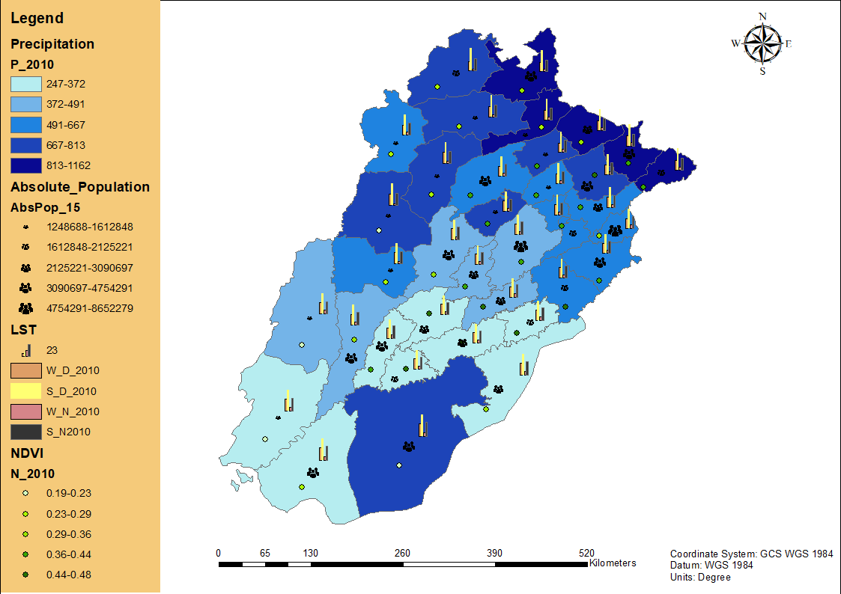

Slide 12
Web Portal Design
Technologies used | Reason for using | Features provided by said technology
HTML, Css and JavaScript | In order to Create the GUI | A stable GUI
Bootstrap Framework | In order to make the web page Responsive | Responsive Web page
Leaflet | For enabling web mapping on the geospatial web portal | Thematic layers/maps
jQuery | In order to create interactions between the map element and other elements on the GUI | Change the layers from the accordion element
Geocoding (plugin) | To allow the user to zoom to his/her searched district of Punjab province of Pakistan | Search bar on the map
Charts.js | In order to create the time varying graphs | Graphical representation of the data
Data Visualization framework plugging leaflet | In order to create the bar-charts of the LST layer | Bar-chart visualization of LST data
Time slider | In order to slide amongst the layers | Visualization of time varying layers
Full screen Plugin | In order to provide the user to view the map on the full screen of his/her device | Full screen viewing option

Slide 13
Creating the map element through Leaflet
Creating the time slider and the graphs for temporal analysis
Visualizing the Data into relevant thematic layers on the map element
Finalizing the web GIS application
Creating the GUI

Slide 14
Implementation
Following are the Snippets of the codes regarding the thematic layers.

Slide 15
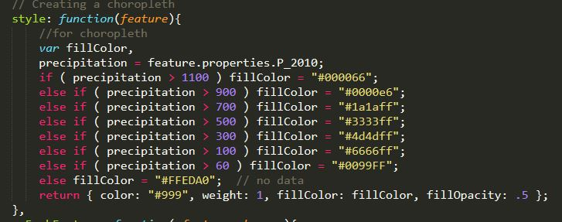
Choropleth Layer

Slide 16
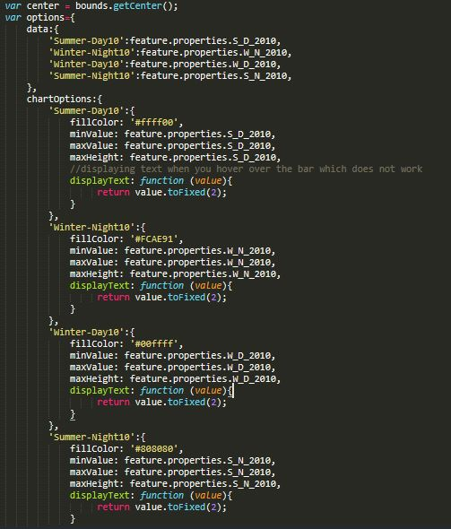
Chart Symbol Layer

Slide 17
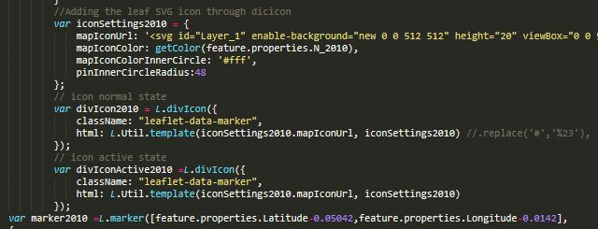
Varying Color Symbol Layer

Slide 18
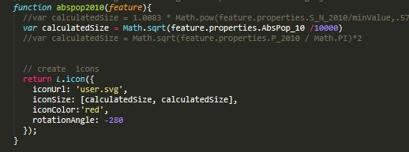
Graduated Symbol Layer

Slide 19
Results and Conclusion
The Result is a web GIS application that would facilitate data visualization and analysis.
This web GIS application can be utilized as a decision support system in case of decisions regarding bio-physical, socio-economic and atmospheric factors of Punjab Pakistan.
Decision making organization, Environmental planning organizations, and research organizations can make use of this web GIS application as it provides thematic visualizations of temporal data as well as graphical representation of said data in just a Click!
The web GIS application is responsive and it accommodates user requirements

Slide 20
